Slide 1
Social Capital Analytics Challenge – Unearthing Economic Connectedness
Presented By
AMIS - University Of Memphis
Project Team
Sree Malya Bathina
Babatunde Dallas
Karthik Reddy Padidam
Raghuram Reddy Peddakapula

Slide 2

Introduction
This project aims to conduct a distributive analysis on how to enhance economic integration by uplifting local communities in USA at the State Level, using the Social Capital datasets.
The datasets provide measures of Social Capital for counties, ZIP codes, high schools, and colleges in the United States based on data from Facebook.
The datasets were developed from a collaboration result by Meta, Opportunity Insights, and researchers from Harvard, New York University, and Stanford.
The datasets are available on the Humanitarian Data Exchange website: https://data.humdata.org/dataset/social-capital-atlas.
The website is managed by the United Nations Office for the coordination of Humanitarian Adairs (OCHA) and is focused on increasing the use and impact of data in the humanitarian sector.
Addition dataset for state name was download on Simple Maps website: https://simplemaps.com/data/us-zips
Addition dataset about Grant Award from the US Health Resources and Services Administration.
Available online https://data.hrsa.gov/data/download
Notes:
Not the decisionmaker. We honestly can’t tell you what you can and cannot do. We can advise you against doing something but the ultimate decision is yours.
Empower and support departments with legal risks and implications with decisions you are making.

Slide 3
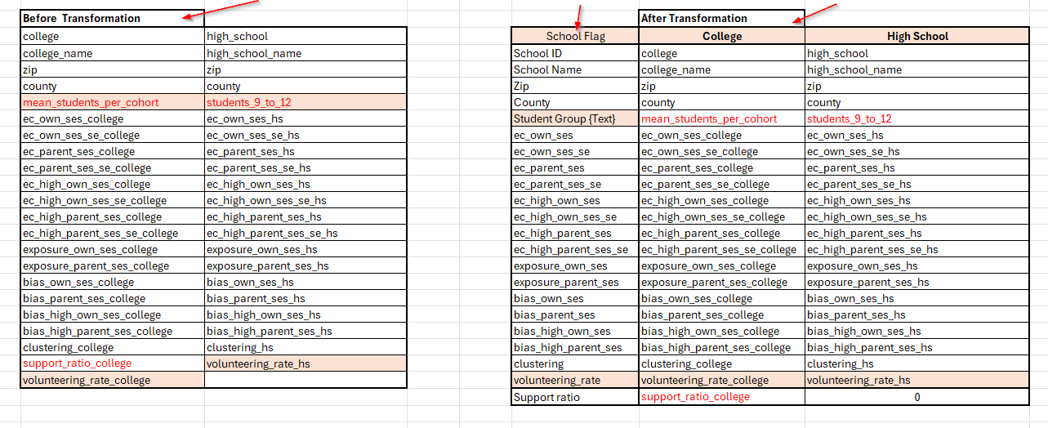

Data Transformation Approach

Slide 4
Defining Social Capital & Key metrics
Social capital:
Benefits gained from positive relationships between Individuals, facilitating trust and cooperation with communities.
Economic Connectedness
Extent to which within a community, individuals with different characteristics are friends with each other.
Exposure
Extent to which different SES people are present in same setiing.
Bias
Tendency of people to make friends of similar socioeconomic status, reinforcing social divisions rather than bridging them.
Notes:
Not the decisionmaker. We honestly can’t tell you what you can and cannot do. We can advise you against doing something but the ultimate decision is yours.
Empower and support departments with legal risks and implications with decisions you are making.

Slide 5
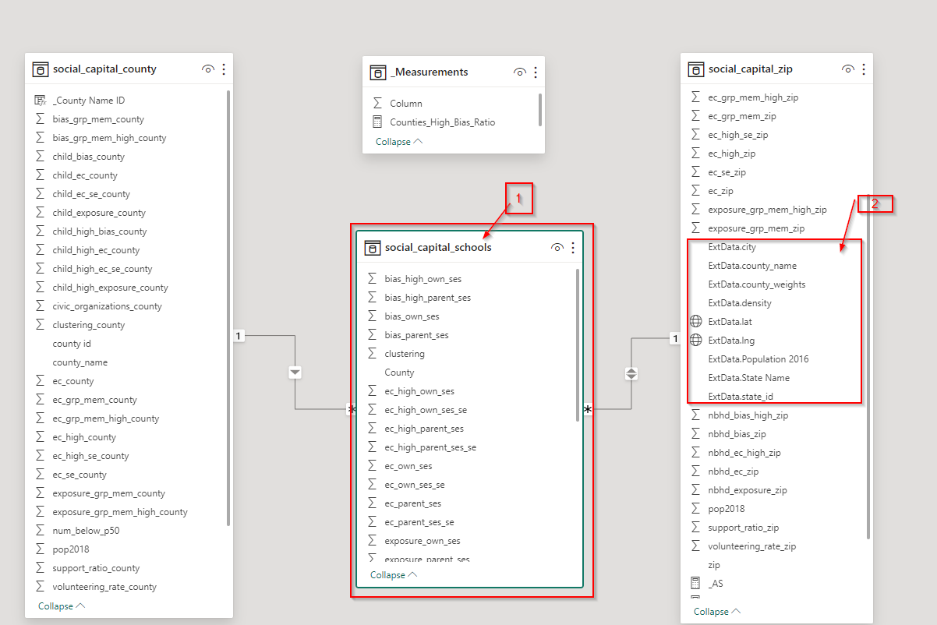
ERD DATA MODEL OVERVIEW

Slide 6
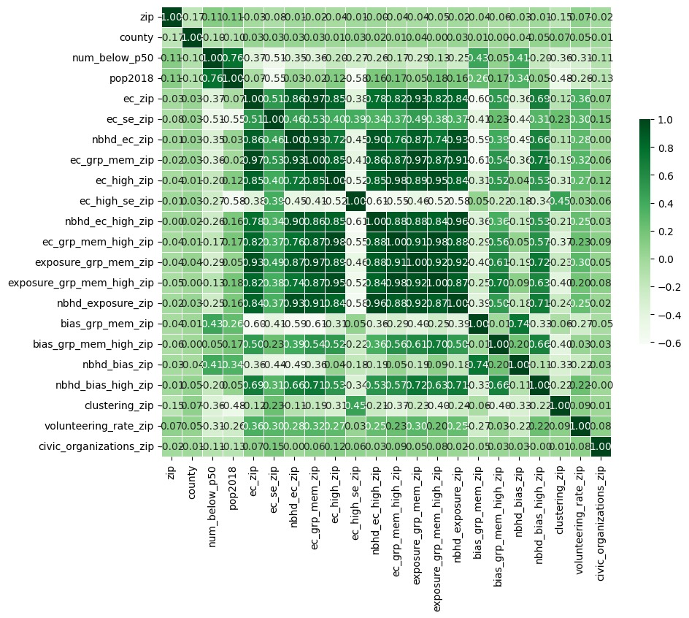
Correlation Matrix by using Python

Slide 7
Factors Influencing Social Connectedness
bias_grp_mem_zip: Negative correlation of -0.59, indicating that biases in group membership can hinder economic connectedness.
nbhd_exposure_zip: Correlation coefficient of 0.93, indicating a very strong positive relationship with neighborhood economic connectedness.
ec_grp_mem_zip: Correlation coefficient of 0.92, showing that economic connectedness within groups is a major factor in overall neighborhood economic connectedness.
ec_zip: Correlation coefficient of 0.86, highlighting the importance of general economic connectedness at the zip code level.
num_below_p50: Negative correlation of -0.35, showing that economic disparities, such as poverty and inequality, are barriers to social cohesion.

Slide 8
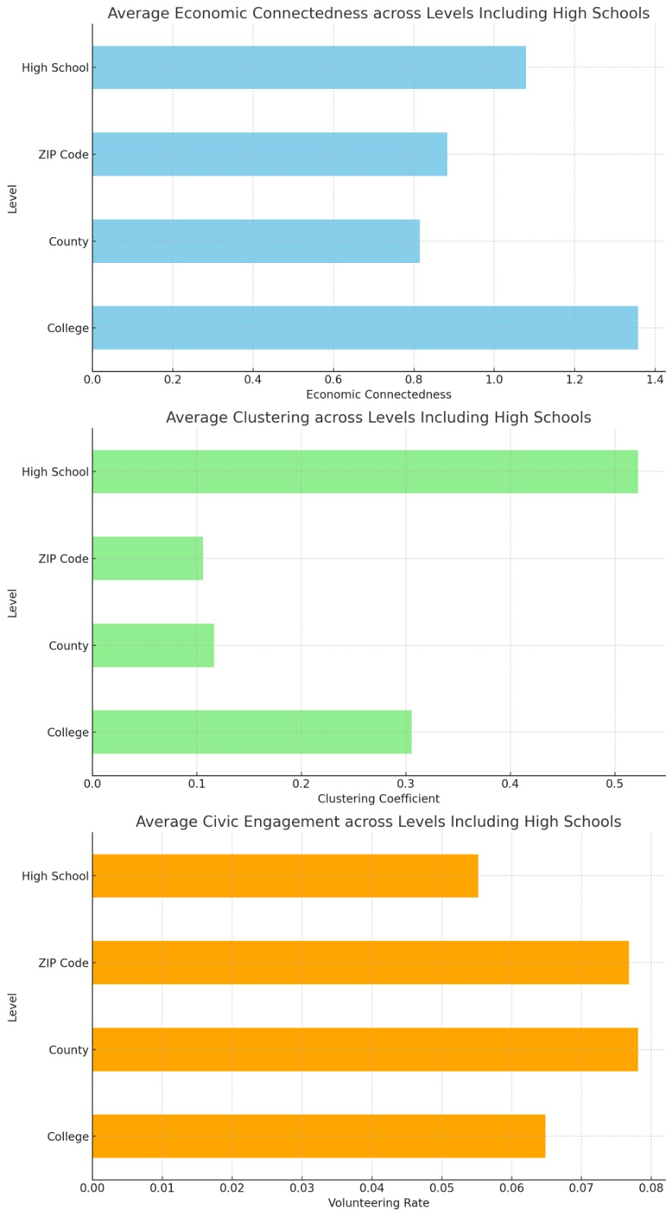
Economic Connectedness across given settings Using Python
Notes:
Not the decisionmaker. We honestly can’t tell you what you can and cannot do. We can advise you against doing something but the ultimate decision is yours.
Empower and support departments with legal risks and implications with decisions you are making.

Slide 9
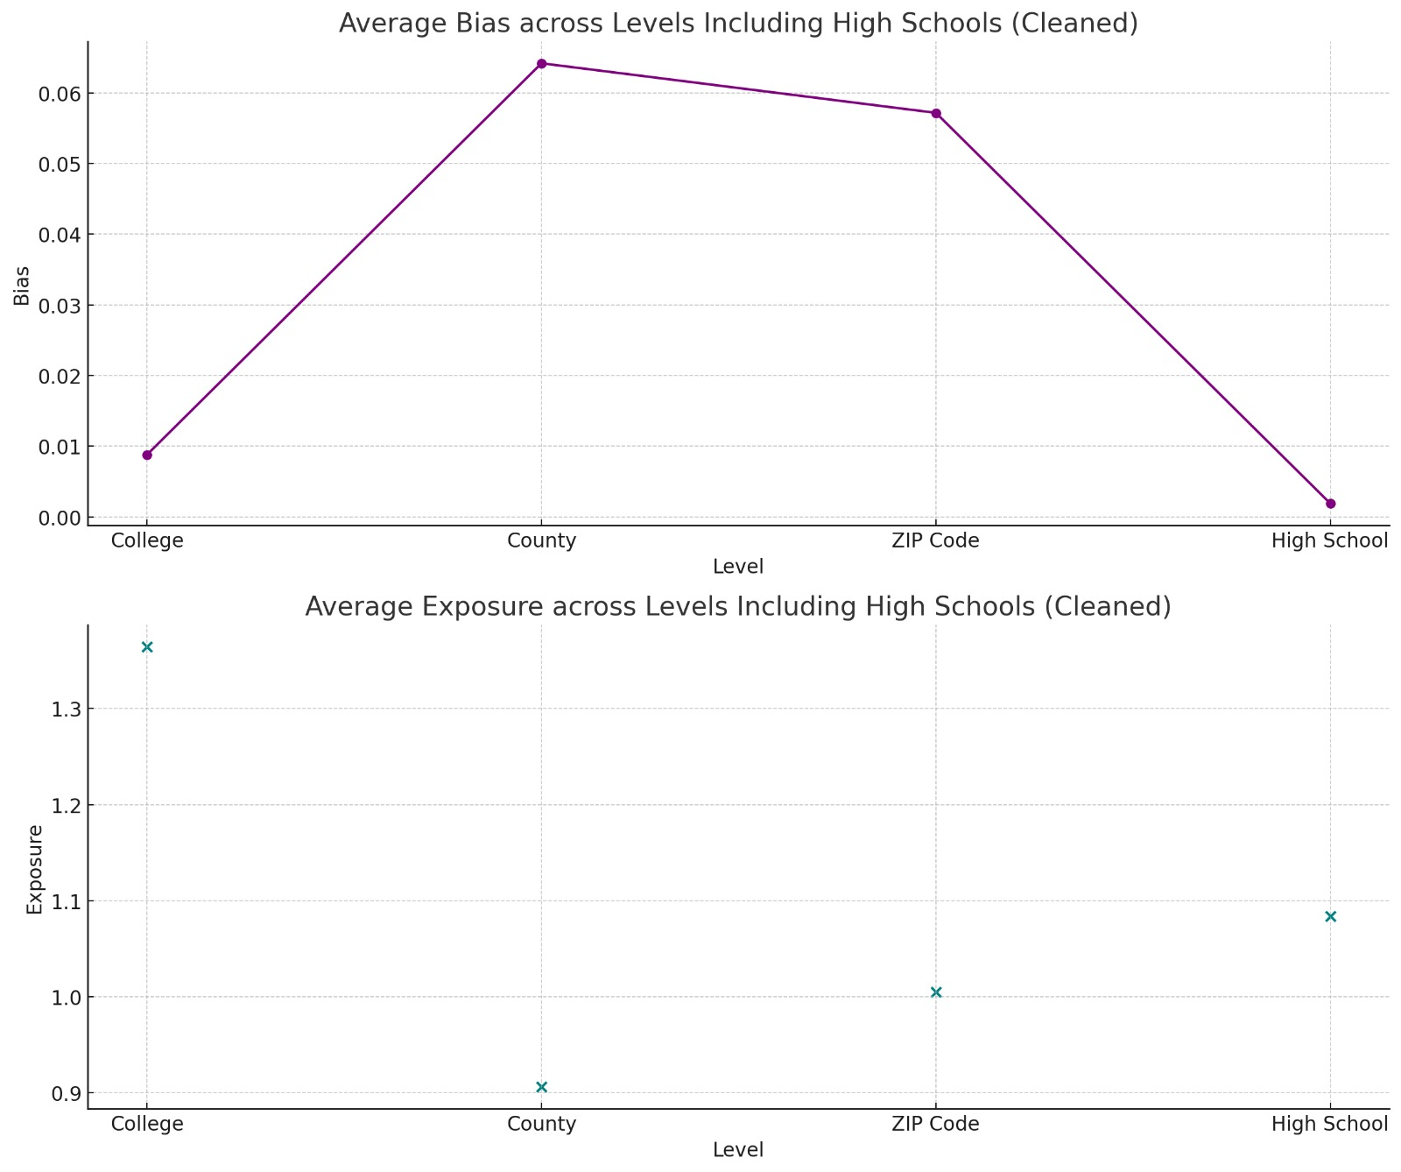
Is economic connectedness solely affected by exposure?
Exposure across different settings
Bias across different settings
Visuals developed using Python

Slide 10
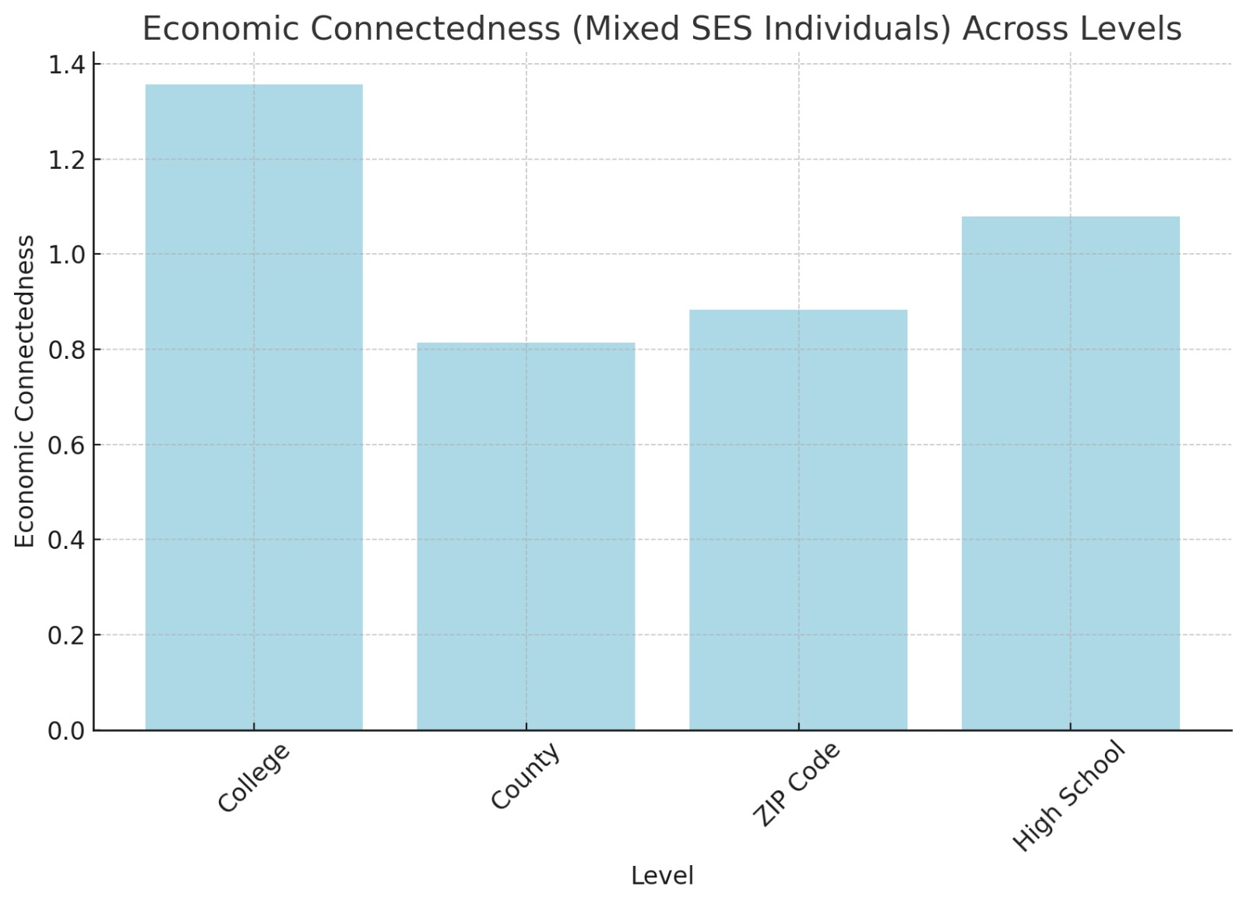
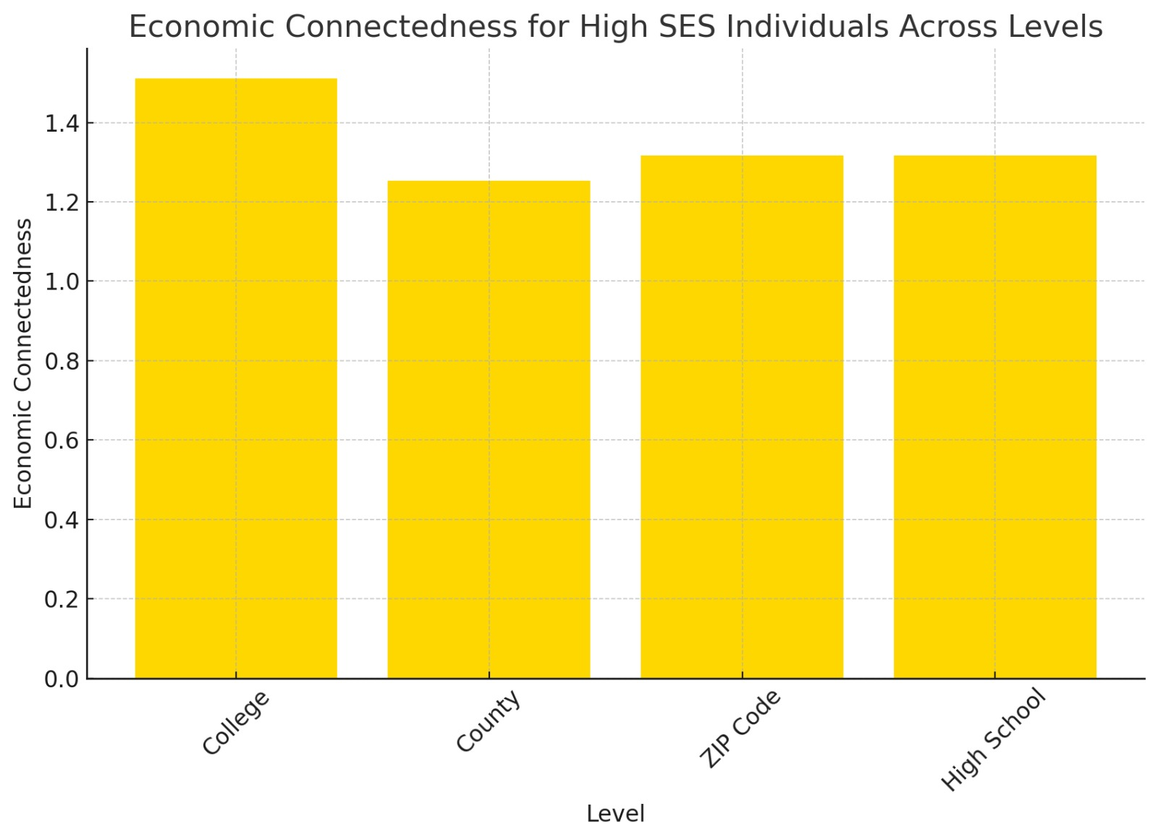
Economic Connectedness Comparison
by High SES and Mixed SES Using Python
Notes:
Not the decisionmaker. We honestly can’t tell you what you can and cannot do. We can advise you against doing something but the ultimate decision is yours.
Empower and support departments with legal risks and implications with decisions you are making.

Slide 11
Observations
If high SES individuals mostly connect with other high SES individuals the economic connectedness within each SES group might be strong, but weak across groups.
We assume interaction also plays an important role along with the integration.
Notes:
Not the decisionmaker. We honestly can’t tell you what you can and cannot do. We can advise you against doing something but the ultimate decision is yours.
Empower and support departments with legal risks and implications with decisions you are making.

Slide 12
What are the areas where interventions might be necessary to foster more inclusive communities?
Enhancing Cross-SES Engagement
Addressing
Addressing In-Group Bias
Fostering
Fostering Civic Engagement Across SES
Improving
Improving Accessibility to Quality Education and Resources
Promoting
Promoting Social Integration in Urban Planning
Leveraging
Leveraging Technology for Inclusion
Enhancing
Notes:
Not the decisionmaker. We honestly can’t tell you what you can and cannot do. We can advise you against doing something but the ultimate decision is yours.
Empower and support departments with legal risks and implications with decisions you are making.

Slide 13
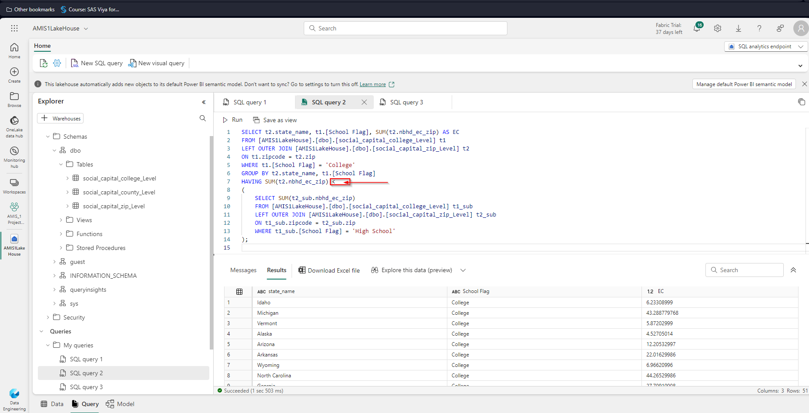
Data Exploration with SQL using Microsoft Fabric
States with lower economic connectedness in Colleges and higher in High school.

Slide 14
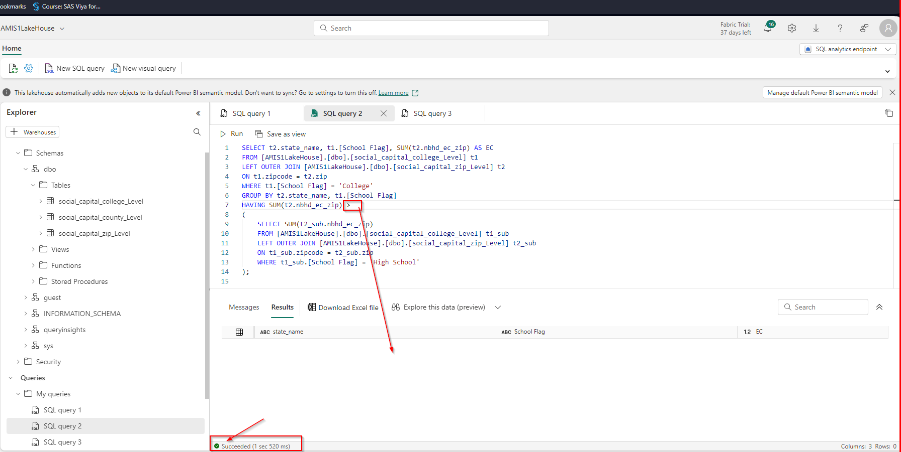
Data Exploration with SQL using Microsoft Fabric
States with higher economic connectedness in Colleges And lower in High schools.

Slide 15
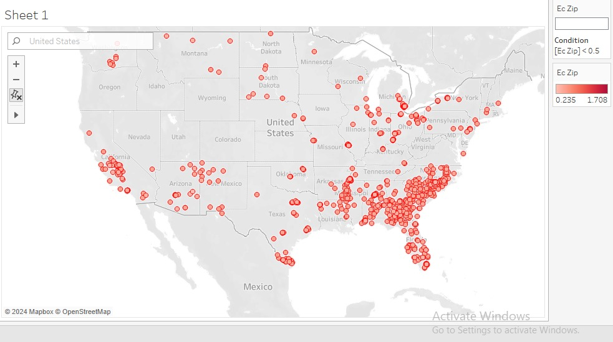
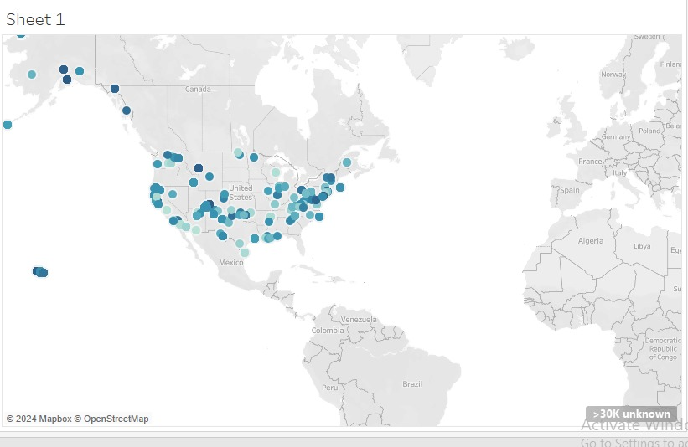
Role of Grant Awards in Economic Connectedness
Visuals developed using Tableau
Grant Awarded by Region
Low Economic Connectedness by Region
Observation: Regions with No Grants Award has Low Economic Connectedness

Slide 16
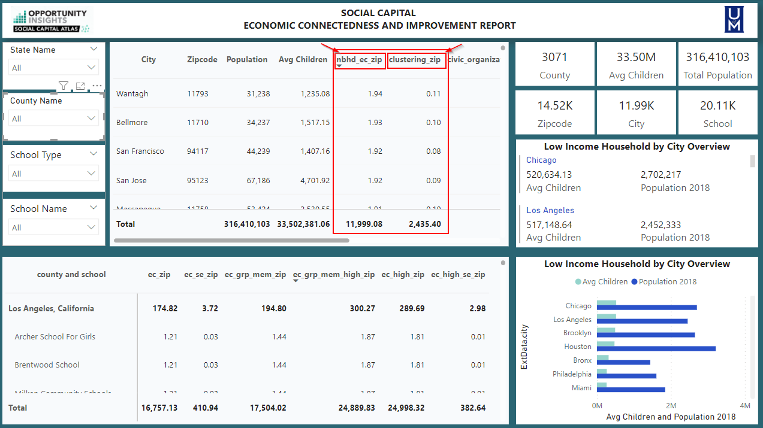
Brain Stormin

Slide 17
Focusing on
Economic connectedness Metrics within the friendly neighborhood (nbhd_ec_zip) and the Clustering Metrics (clustering_zip) at the local community using zip code. ​
nbhd_ec_zip refers to the ranking calculated metrics of friendly neighborhoods between 0 and 1.94. The higher the metrics indicate friendly neighborhoods in all local communities across the USA.​
clustering_zip refers to the average fraction of friendly people who are also friends. ​
The higher the metrics in both Variable indicate a friendly neighborhood and vice versa.​
Focusing on the lower indicator metrics can significantly impact economic integration and uplift communities because nbhd_ec_zip focuses on economic diversity within a neighborhood’s social network, and clustering_zip measures how interconnected an individual’s friends are.​

Slide 18
Actionable Steps to Enhance Economic Integration
Introduce business incubation programs.
Develop a Smart Database system.
Implementing Inclusive Infrastructure Design of Educational institutions.
Professional Training Program
Encouraging Corporate Social Responsibility activities.
Creating rewards in High-Performing Areas.

Slide 19
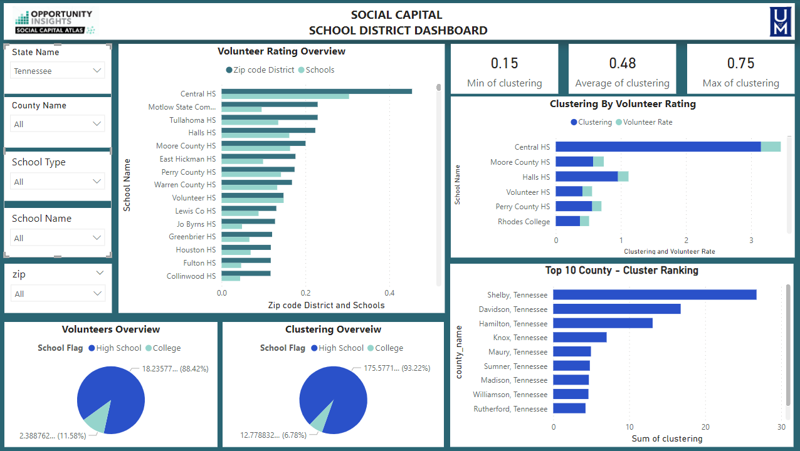
Brain Stormin

Slide 20

Actionable Steps to start small.
Early Childhood Education
Performing Implicit bias test for students in different SES schools.
Implementing SEZs

Slide 21

Future approaches
Utilize
Utilize Hybrid Models like Ensemble Methods to enhance prediction accuracy by combining strengths of different algorithms.
Apply
Apply Natural Language Processing (NLP) for sentiment analysis and topic modeling to understand community issues and social cohesion
Incorporate
Incorporate Deep Learning Techniques, such as Neural Networks and CNNs, for capturing complex data patterns and spatial relationships.

Slide 22

The Power of Connection
Change extends beyond policy; it starts with individual actions.
Networking is vital: Our connections define our strength.
Embrace diversity in your personal and professional circles.
Takeaway: Cultivate connections to thrive in today's world.
Call to Action: Begin now—forge a new friendship today.
Notes:
Not the decisionmaker. We honestly can’t tell you what you can and cannot do. We can advise you against doing something but the ultimate decision is yours.
Empower and support departments with legal risks and implications with decisions you are making.

Slide 23

Thank you..

